Slide 1

The Coalition of Texans with Disabilities
Special Presentation to Bridges Conference
Houston May 3, 2018

Slide 2
About how much of Texas Medicaid is in managed care?
90%
66%
40%

Slide 3

Harris County STAR Plus pilot
2005 Battle of the Titans

Slide 4
Harris County MCOs
STAR
-
Amerigroup, Community Health Choice, Molina, Texas Children's, United
STAR+PLUS
-
Amerigroup, Molina, United
STAR Kids
-
Amerigroup, Texas Children's, United
CHIP
-
Amerigroup, Community Health Choice, Molina, Texas Children's, United

Slide 5
Decision makers in Medicaid
Managed Care Organizations
Texas Health and Human Services Commission
Legislature

Slide 6

Shortage of Docs Accepting
Medicaid Consumers
Managed Care Organizations
Texas Health and Human Services Commission
Legislature

Slide 7
Which MCOs serve my area
Managed Care Organizations
Texas Health and Human Services Commission
Legislature

Slide 8
Difficult to Retain Home Health Workers
Managed Care Organizations
Texas Health and Human Services Commission
Legislature

Slide 9
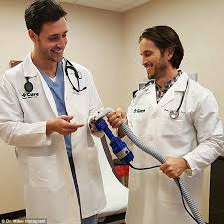
The Network of Specialists is Too Small
Managed Care Organizations
Texas Health and Human Services Commission
Legislature

Slide 10

Ensuring Accountability for Services
Managed Care Organizations
Texas Health and Human Services Commission
Legislature

Slide 11

True or False
Eight years ago, State officials said that 50% of people with intellectual and developmental disabilities currently in nursing homes could never live successfully in the community.

Slide 12

False!
State officials said that 100 % of these people were too disabled to live in the community.

Slide 13
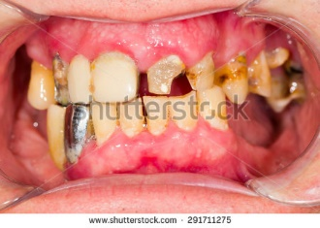
Critical Needs that can be much better!

Slide 14
Medicaid Dental Benefits for Adults
Better: Nutrition, Health, Employability, Social Opportunities
Less: Emergency Rooms, Opioid Rx

Slide 15
Crushing The Workforce

Slide 19
Know your policymakers
Get your policymakers to know you
Face of the issue
Value of the issue
Join a group/organization

Slide 20
The Coalition of Texans with Disabilities
www.txdisabilities.org
www.facebook.com/TxDisabilities

